Slide 1
Computational Basics
Dr. Rashmi Mahajan

Slide 2
Linear Regression | Logistic Regression
Linear Regression is a supervised regression model. | Logistic Regression is a supervised classification model.
In Linear Regression, we predict the value by an integer number. | In Logistic Regression, we predict the value by 1 or 0.
Here no activation function is used. | Here activation function is used to convert a linear regression equation to the logistic regression equation
Here no threshold value is needed. | Here a threshold value is added.
Here we calculate Root Mean Square Error(RMSE) to predict the next weight value. | Here we use precision to predict the next weight value.
Here dependent variable should be numeric and the response variable is continuous to value. | Here the dependent variable consists of only two categories. Logistic regression estimates the odds outcome of the dependent variable given a set of quantitative or categorical independent variables.
It is based on the least square estimation. | It is based on maximum likelihood estimation.
Here when we plot the training datasets, a straight line can be drawn that touches maximum plots. | Any change in the coefficient leads to a change in both the direction and the steepness of the logistic function. It means positive slopes result in an S-shaped curve and negative slopes result in a Z-shaped curve.
Linear regression is used to estimate the dependent variable in case of a change in independent variables. For example, predict the price of houses. | Whereas logistic regression is used to calculate the probability of an event. For example, classify if tissue is benign or malignant.
Linear regression assumes the normal or gaussian distribution of the dependent variable. | Logistic regression assumes the binomial distribution of the dependent variable.

Slide 3
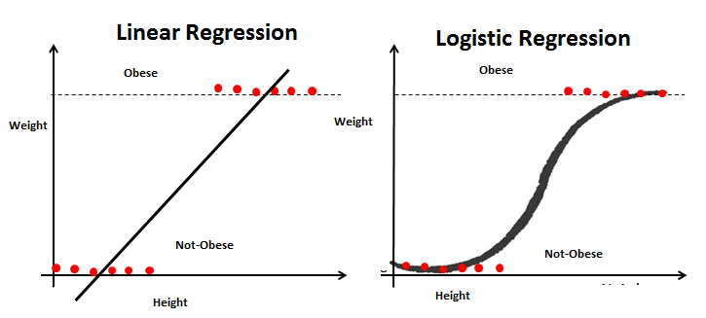

Slide 4
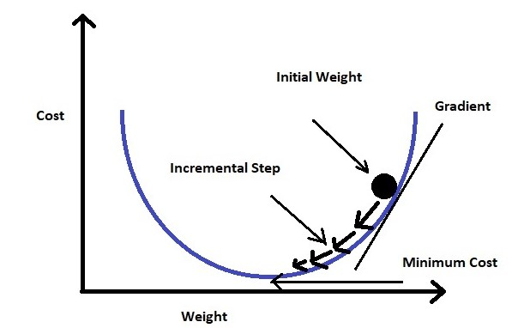
Error function

Slide 5
Let’s assume that we have a dataset where x is the independent variable and Y is a function of x (Y=f(x)). Thus, by using Linear Regression we can form the following equation (equation for the best-fitted line):
Y = mx + c
in our equation weights are m and c

Slide 6
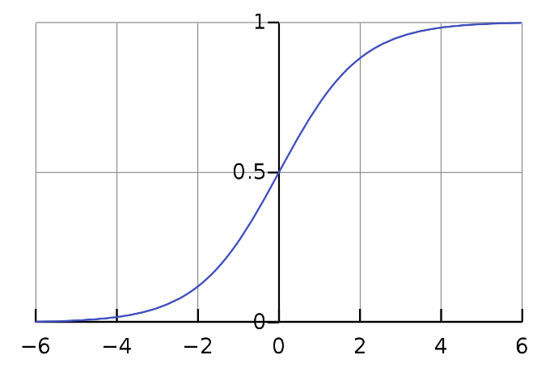
Sigmoid function

Slide 7
Loss function
Loss function
Loss function: Used when we refer to the error for a single training example.
Cost function: Used to refer to an average of the loss functions over an entire training dataset.

Slide 8
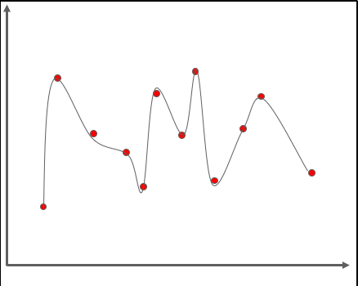
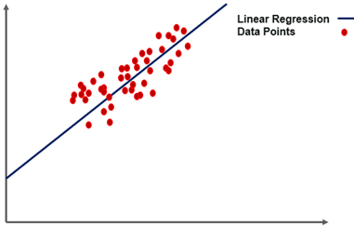
overfitting
What is Overfitting In Machine Learning?
A statistical model is said to be overfitted when we feed it a lot more data than necessary. To make it relatable, imagine trying to fit into oversized apparel.

Slide 9
Overfitting
Model
Data
Model will train itself
Predict
Example is suppose I want to find out no of literate persons rate (percentage)
Data :District , state, country
Variety of data may give misinterpretation to the model
No fo reasons

Slide 10
overfitting
If we take an example of simple linear regression, training the data is all about finding out the minimum cost between the best fit line and the data points. It goes through a number of iterations to find out the optimum best fit, minimizing the cost. This is where overfitting comes into the picture

Slide 11
The line seen in the image above can give a very efficient outcome for a new data point. In the case of overfitting, when we run the training algorithm on the data set, we allow the cost to reduce with each number of iteration.
Running this algorithm for too long will mean a reduced cost but it will also fit the noisy data from the data set. The result would look something like in the graph below.

Slide 12
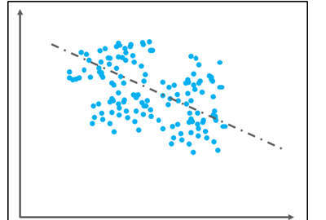
In order to avoid overfitting, we could stop the training at an earlier stage.
But it might also lead to the model not being able to learn enough from training data, that it may find it difficult to capture the dominant trend.
This is known as underfitting. The result is the same as overfitting, inefficiency in predicting outcomes.
Now that we have understood what underfitting and overfitting in Machine Learning really is, let us try to understand how we can detect overfitting in Machine Learning.

Slide 13
The Trade-off Between Bias And Variance
Bias
It is nothing but the difference between the predicted values and the actual or true values in the model. It is not always easy for the model to learn from rather complex signals.

Slide 14
Variance
It refers to the model’s sensitivity to specific sets in the training data. A high variance algorithm will produce a bizarre model that is drastically different from the training set.

Slide 15
Bias-Variance Trade-off
A Machine Learning algorithm cannot be perceived as a one-time method for training the model, instead, it is a repetitive process.
Low variance-high bias algorithms are less complex, with a simple and rigid structure.
They will train the models that are consistent, but inaccurate on average.
These include linear or parametric algorithms, such as regression, Naive Bayes, etc.
High variance-low bias algorithms tend to be more complex, with a flexible structure.
They will train the models that are inconsistent but accurate on average.
These include non-linear or non-parametric algorithms such as decision trees, Nearest neighbor, etc.
This brings us to the end of this article where we have learned Overfitting in Machine learning and about various techniques to avoid it. I hope you are clear with all that has been shared with you in this tutorial.

Slide 16
THANKS………………

